Slide 1
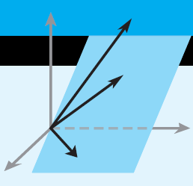
Elementary Linear Algebra
Howard Anton
Copyright © 2010 by John Wiley & Sons, Inc.
All rights reserved.
Notes:
*

Slide 2
Matrices and Matrix Operations
Definition 1 A matrix is a rectangular array of numbers. The numbers in the array are called the entries of the matrix.
The size of a matrix M is written in terms of the number of its rows x the number of its columns. A 2x3 matrix has 2 rows and 3 columns
Notes:
*

Slide 3
Arithmetic of Matrices
A + B: add the corresponding entries of A and B
A – B: subtract the corresponding entries of B from those of A
Matrices A and B must be of the same size to be added or subtracted
cA (scalar multiplication): multiply each entry of A by the constant c
Notes:
*

Slide 4
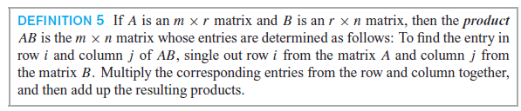
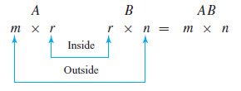
Multiplication of Matrices
Notes:
*

Slide 5
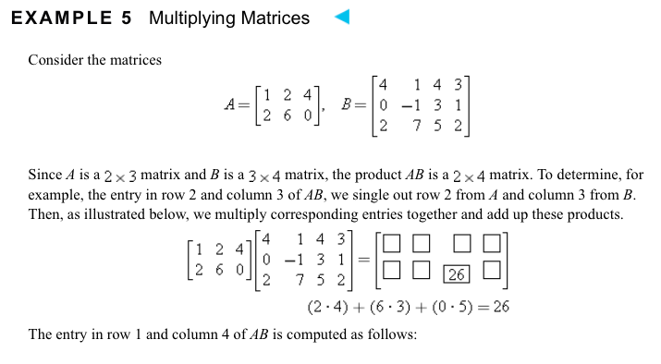

Slide 6
